Slide 1

Module 4

Slide 2
Transport Layer
Transport Layer Services, Connectionless & Connection-oriented Protocols
Transport Layer protocols: User Datagram Protocol: UDP Services, UDP Applications, Transmission Control Protocol: TCP Services, TCP Features, Segment, A TCP Connection, Windows in TCP, Flow Control, Error Control, TCP Congestion Control, TCP Timers.
Session Layer:
Session layer design issues, Session Layer protocol - Remote Procedure Call (RPC),

Slide 3
The transport layer is a 4th layer from the top.
The main role of the transport layer is to provide the communication services directly to the application processes running on different hosts.
The transport layer protocols are implemented in the end systems but not in the network routers.
A computer network provides more than one protocol to the network applications. For example, TCP and UDP are two transport layer protocols that provide a different set of services to the network layer.
All transport layer protocols provide multiplexing/demultiplexing service. It also provides other services such as reliable data transfer, bandwidth guarantees, and delay guarantees.
Each of the applications in the application layer has the ability to send a message by using TCP or UDP. The application communicates by using either of these two protocols. Both TCP and UDP will then communicate with the internet protocol in the internet layer. The applications can read and write to the transport layer. Therefore, we can say that communication is a two-way process.

Slide 4
network layer: logical communication between hosts
transport layer: logical communication between processes
relies on, enhances, network layer services
Household analogy:
12 kids sending letters to 12 kids
processes = kids
app messages = letters in envelopes
hosts = houses
transport protocol = Ann and Bill
network-layer protocol = postal service

Slide 5
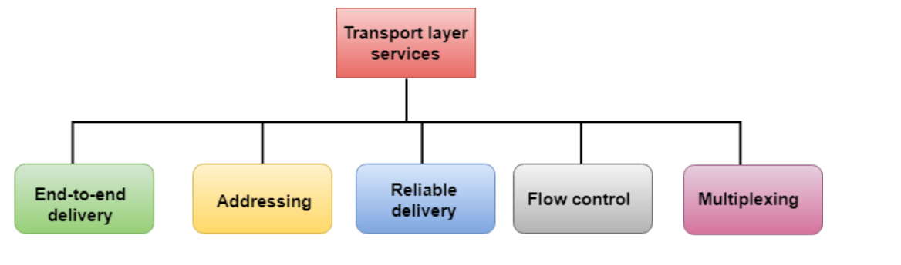
The services provided by the transport layer protocols can be divided into five categories:
End-to-end delivery
Addressing
Reliable delivery
Flow control
Multiplexing

Slide 6
End-to-end delivery:
The transport layer transmits the entire message to the destination. Therefore, it ensures the end-to-end delivery of an entire message from a source to the destination.
Reliable delivery:
The transport layer provides reliability services by retransmitting the lost and damaged packets.
The reliable delivery has four aspects:
Error control
Sequence control
Loss control
Duplication control

Slide 7
Error Control
The primary role of reliability is Error Control. In reality, no transmission will be 100 percent error-free delivery. Therefore, transport layer protocols are designed to provide error-free transmission.
Sequence Control
The second aspect of the reliability is sequence control which is implemented at the transport layer.
On the sending end, the transport layer is responsible for ensuring that the packets received from the upper layers can be used by the lower layers. On the receiving end, it ensures that the various segments of a transmission can be correctly reassembled.
Loss Control
Loss Control is a third aspect of reliability. The transport layer ensures that all the fragments of a transmission arrive at the destination, not some of them. On the sending end, all the fragments of transmission are given sequence numbers by a transport layer. These sequence numbers allow the receiver?s transport layer to identify the missing segment.

Slide 8
Duplication Control
Duplication Control is the fourth aspect of reliability. The transport layer guarantees that no duplicate data arrive at the destination. Sequence numbers are used to identify the lost packets; similarly, it allows the receiver to identify and discard duplicate segments.
Flow Control
Flow control is used to prevent the sender from overwhelming the receiver. If the receiver is overloaded with too much data, then the receiver discards the packets and asking for the retransmission of packets. This increases network congestion and thus, reducing the system performance. The transport layer is responsible for flow control. It uses the sliding window protocol that makes the data transmission more efficient as well as it controls the flow of data so that the receiver does not become overwhelmed. Sliding window protocol is byte oriented rather than frame oriented.

Slide 9
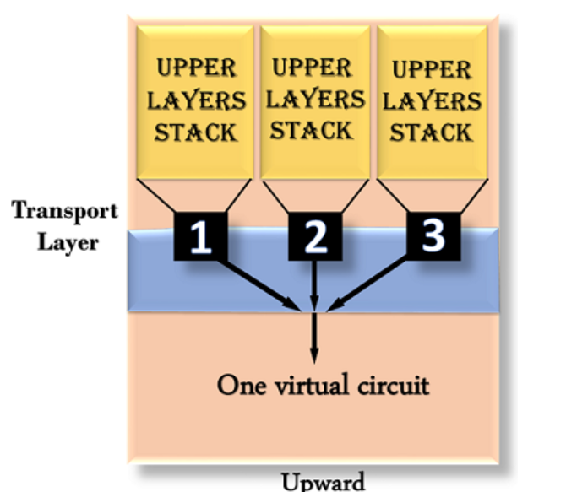
Multiplexing
The transport layer uses the multiplexing to improve transmission efficiency.
Multiplexing can occur in two ways:
Upward multiplexing: Upward multiplexing means multiple transport layer connections use the same network connection. To make more cost-effective, the transport layer sends several transmissions bound for the same destination along the same path; this is achieved through upward multiplexing.

Slide 10
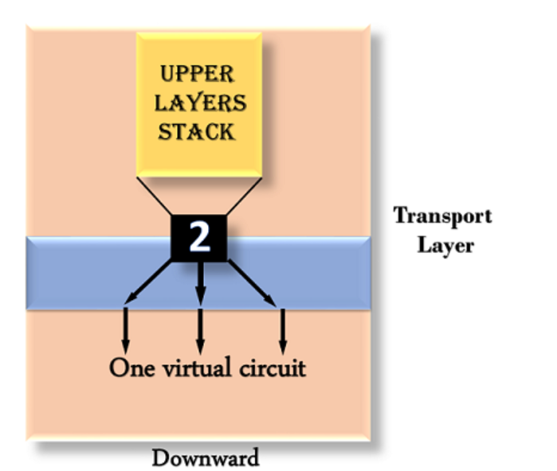
Downward multiplexing: Downward multiplexing means one transport layer connection uses the multiple network connections. Downward multiplexing allows the transport layer to split a connection among several paths to improve the throughput. This type of multiplexing is used when networks have a low or slow capacity.

Slide 11
Addressing
According to the layered model, the transport layer interacts with the functions of the session layer. Many protocols combine session, presentation, and application layer protocols into a single layer known as the application layer. In these cases, delivery to the session layer means the delivery to the application layer. Data generated by an application on one machine must be transmitted to the correct application on another machine. In this case, addressing is provided by the transport layer.
The transport layer provides the user address which is specified as a station or port. The port variable represents a particular TS user of a specified station known as a Transport Service access point (TSAP). Each station has only one transport entity.
The transport layer protocols need to know which upper-layer protocols are communicating.

Slide 12
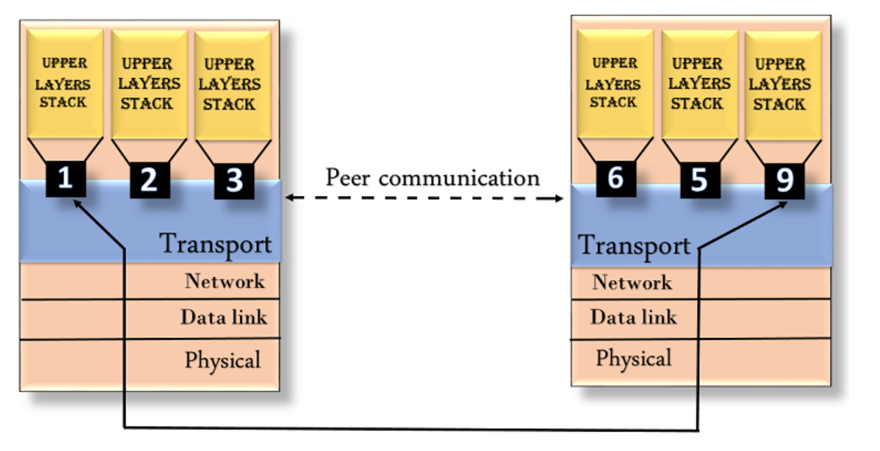

Slide 13
Transport Layer protocols
The transport layer is represented by two protocols: TCP and UDP.
The IP protocol in the network layer delivers a datagram from a source host to the destination host.
Nowadays, the operating system supports multiuser and multiprocessing environments, an executing program is called a process. When a host sends a message to other host means that source process is sending a process to a destination process. The transport layer protocols define some connections to individual ports known as protocol ports.
An IP protocol is a host-to-host protocol used to deliver a packet from source host to the destination host while transport layer protocols are port-to-port protocols that work on the top of the IP protocols to deliver the packet from the originating port to the IP services, and from IP services to the destination port.
Each port is defined by a positive integer address, and it is of 16 bits.

Slide 14
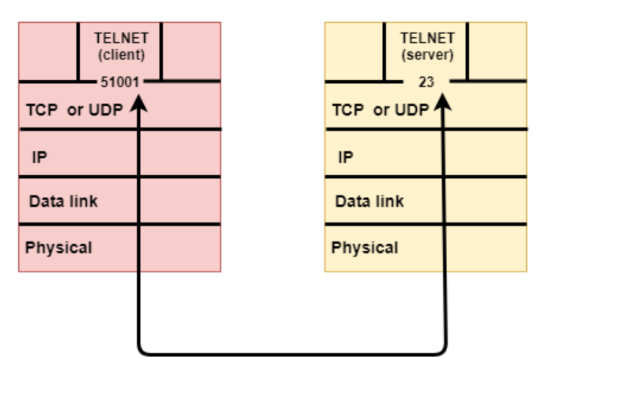

Slide 15
UDP
UDP stands for User Datagram Protocol.
UDP is a simple protocol and it provides no sequenced transport functionality.
UDP is a connectionless protocol.
This type of protocol is used when reliability and security are less important than speed and size.
UDP is an end-to-end transport level protocol that adds transport-level addresses, checksum error control, and length information to the data from the upper layer.
The packet produced by the UDP protocol is known as a user datagram.

Slide 16
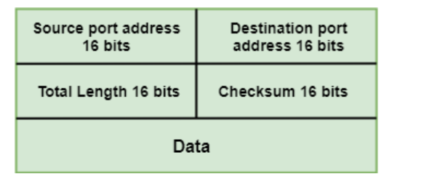
User Datagram Format
The user datagram has a 16-byte header which is shown below:

Slide 17
Where,
Source port address: It defines the address of the application process that has delivered a message. The source port address is of 16 bits address.
Destination port address: It defines the address of the application process that will receive the message. The destination port address is of a 16-bit address.
Total length: It defines the total length of the user datagram in bytes. It is a 16-bit field.
Checksum: The checksum is a 16-bit field which is used in error detection.

Slide 18
Disadvantages of UDP protocol
UDP provides basic functions needed for the end-to-end delivery of a transmission.
It does not provide any sequencing or reordering functions and does not specify the damaged packet when reporting an error.
UDP can discover that an error has occurred, but it does not specify which packet has been lost as it does not contain an ID or sequencing number of a particular data segment.

Slide 19
TCP
TCP stands for Transmission Control Protocol.
It provides full transport layer services to applications.
It is a connection-oriented protocol means the connection established between both the ends of the transmission. For creating the connection, TCP generates a virtual circuit between sender and receiver for the duration of a transmission.

Slide 20
Features Of TCP protocol
Stream data transfer: TCP protocol transfers the data in the form of contiguous stream of bytes. TCP group the bytes in the form of TCP segments and then passed it to the IP layer for transmission to the destination. TCP itself segments the data and forward to the IP.
Reliability: TCP assigns a sequence number to each byte transmitted and expects a positive acknowledgement from the receiving TCP. If ACK is not received within a timeout interval, then the data is retransmitted to the destination. The receiving TCP uses the sequence number to reassemble the segments if they arrive out of order or to eliminate the duplicate segments.
Flow Control: When receiving TCP sends an acknowledgement back to the sender indicating the number the bytes it can receive without overflowing its internal buffer. The number of bytes is sent in ACK in the form of the highest sequence number that it can receive without any problem. This mechanism is also referred to as a window mechanism.

Slide 21
Multiplexing: Multiplexing is a process of accepting the data from different applications and forwarding to the different applications on different computers. At the receiving end, the data is forwarded to the correct application. This process is known as demultiplexing. TCP transmits the packet to the correct application by using the logical channels known as ports.
Logical Connections: The combination of sockets, sequence numbers, and window sizes, is called a logical connection. Each connection is identified by the pair of sockets used by sending and receiving processes.
Full Duplex: TCP provides Full Duplex service, i.e., the data flow in both the directions at the same time. To achieve Full Duplex service, each TCP should have sending and receiving buffers so that the segments can flow in both the directions. TCP is a connection-oriented protocol. Suppose the process A wants to send and receive the data from process B. The following steps occur:
Establish a connection between two TCPs.
Data is exchanged in both the directions.
The Connection is terminated.

Slide 22
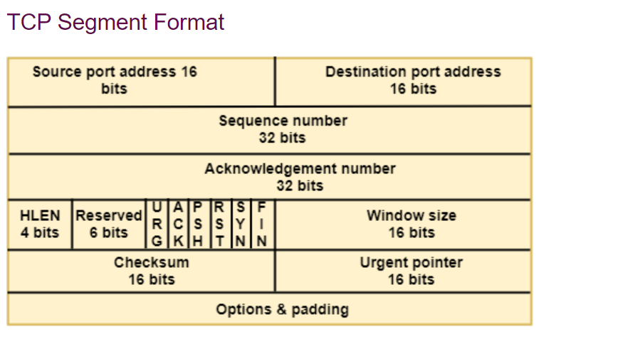

Slide 23
Where,
Source port address: It is used to define the address of the application program in a source computer. It is a 16-bit field.
Destination port address: It is used to define the address of the application program in a destination computer. It is a 16-bit field.
Sequence number: A stream of data is divided into two or more TCP segments. The 32-bit sequence number field represents the position of the data in an original data stream.
Acknowledgement number: A 32-field acknowledgement number acknowledge the data from other communicating devices. If ACK field is set to 1, then it specifies the sequence number that the receiver is expecting to receive.
Header Length (HLEN): It specifies the size of the TCP header in 32-bit words. The minimum size of the header is 5 words, and the maximum size of the header is 15 words. Therefore, the maximum size of the TCP header is 60 bytes, and the minimum size of the TCP header is 20 bytes.
Reserved: It is a six-bit field which is reserved for future use.
Control bits: Each bit of a control field functions individually and independently. A control bit defines the use of a segment or serves as a validity check for other fields.

Slide 24
There are total six types of flags in control field:
URG: The URG field indicates that the data in a segment is urgent.
ACK: When ACK field is set, then it validates the acknowledgement number.
PSH: The PSH field is used to inform the sender that higher throughput is needed so if possible, data must be pushed with higher throughput.
RST: The reset bit is used to reset the TCP connection when there is any confusion occurs in the sequence numbers.
SYN: The SYN field is used to synchronize the sequence numbers in three types of segments: connection request, connection confirmation ( with the ACK bit set ), and confirmation acknowledgement.
FIN: The FIN field is used to inform the receiving TCP module that the sender has finished sending data. It is used in connection termination in three types of segments: termination request, termination confirmation, and acknowledgement of termination confirmation.

Slide 25
Window Size: The window is a 16-bit field that defines the size of the window.
Checksum: The checksum is a 16-bit field used in error detection.
Urgent pointer: If URG flag is set to 1, then this 16-bit field is an offset from the sequence number indicating that it is a last urgent data byte.
Options and padding: It defines the optional fields that convey the additional information to the receiver.

Slide 26
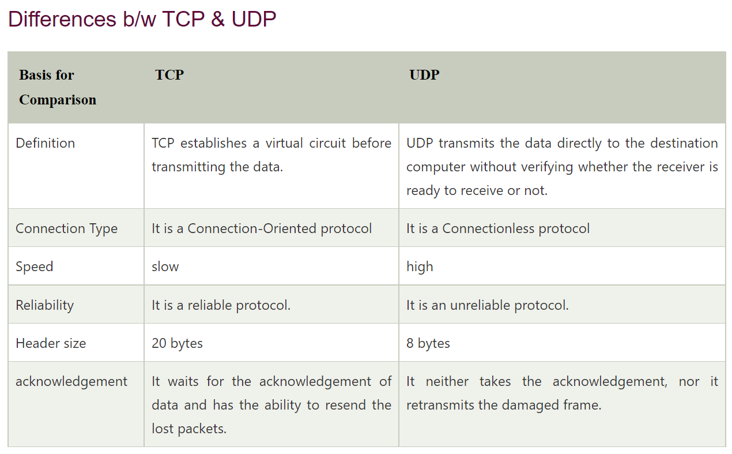

Slide 27
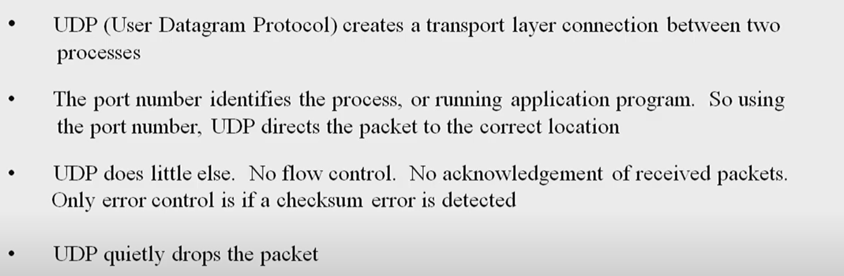
UDP

Slide 28
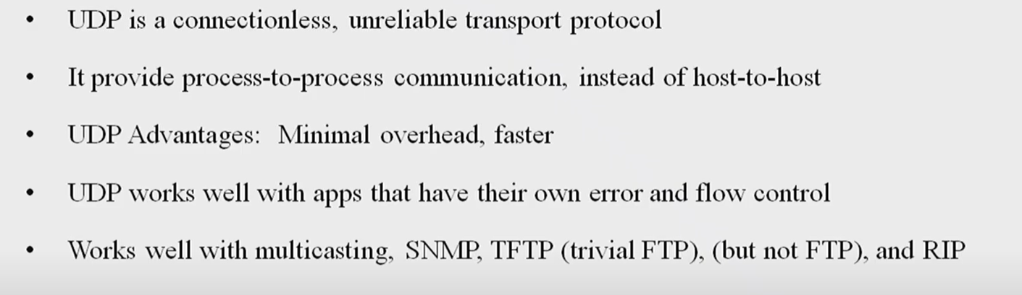

Slide 29
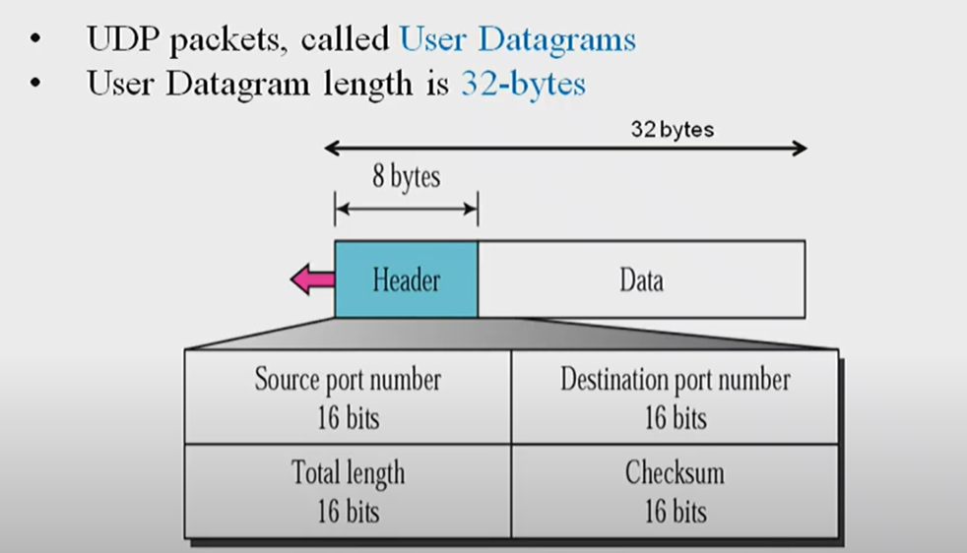

Slide 30
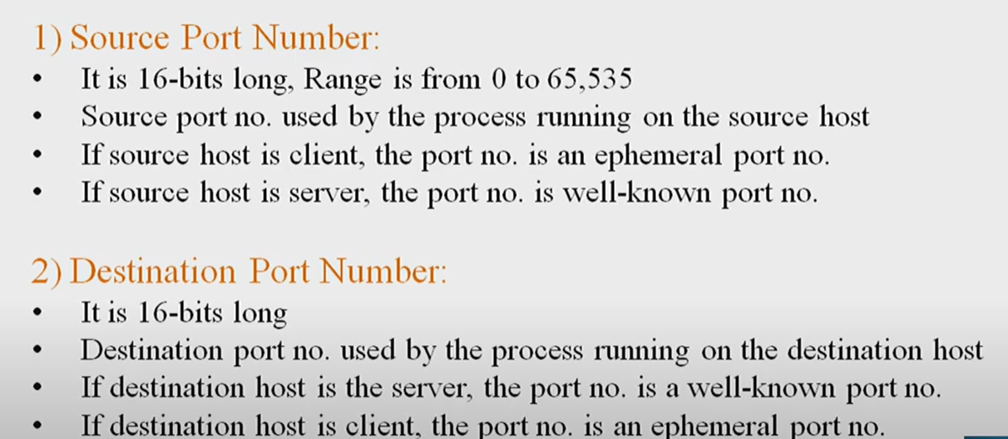

Slide 31
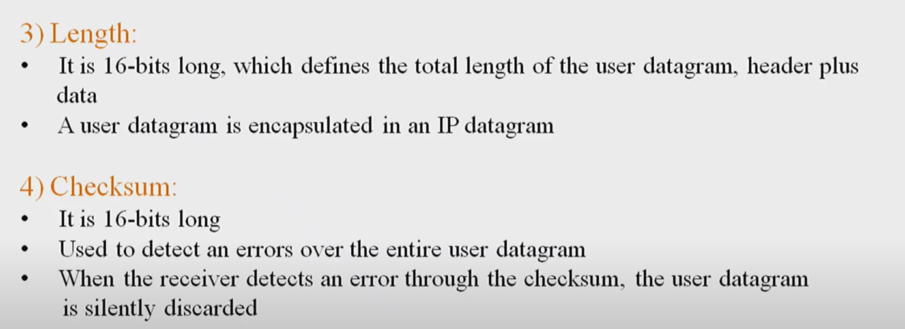

Slide 32
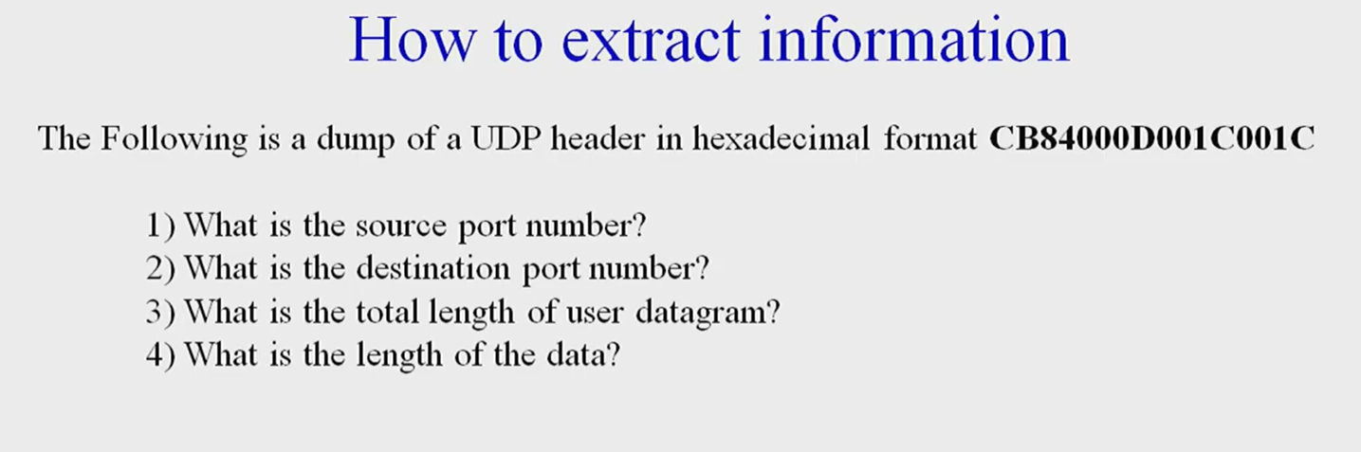

Slide 33
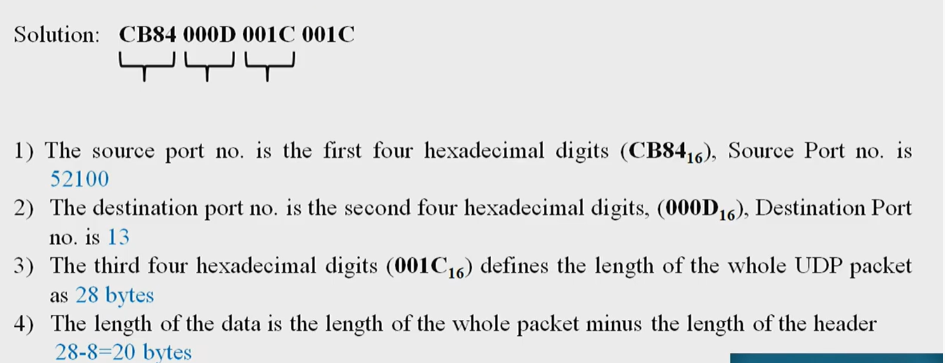

Slide 34
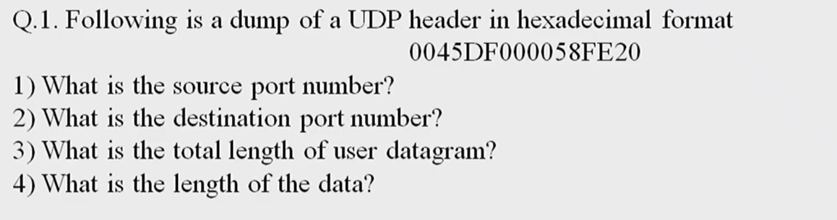

Slide 35
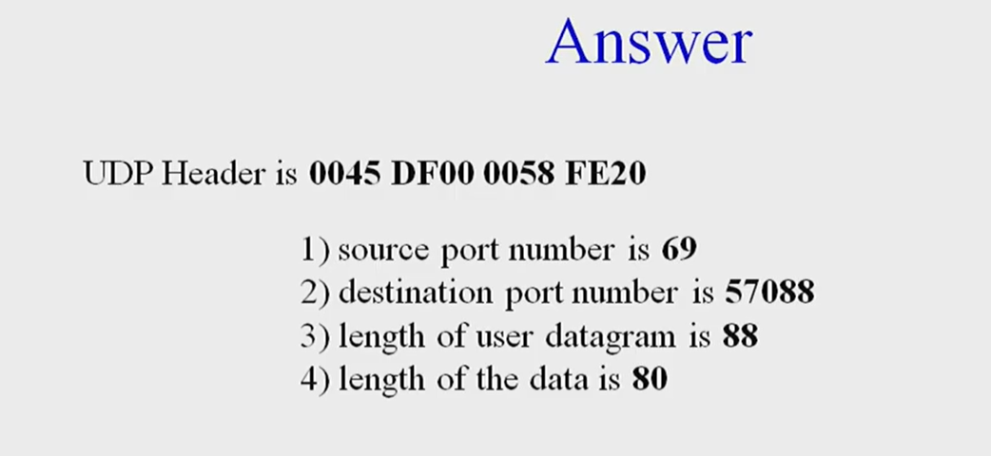

Slide 36
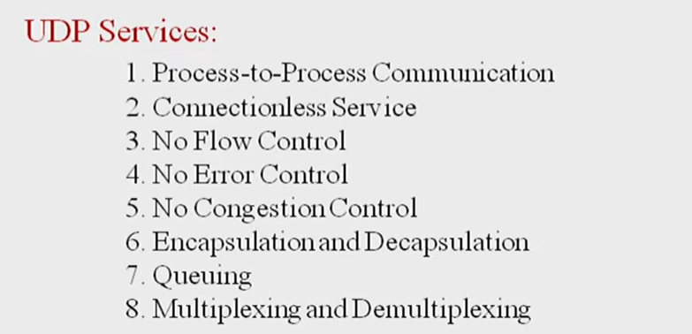
UDP SERVICES

Slide 37
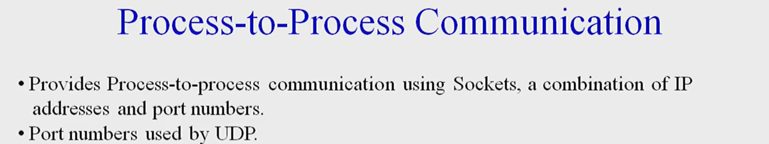
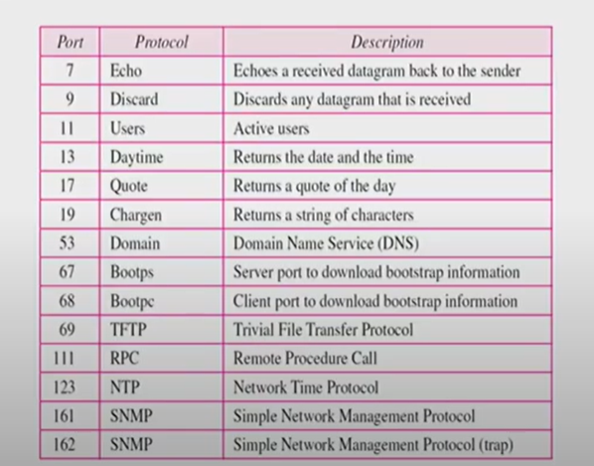

Slide 38
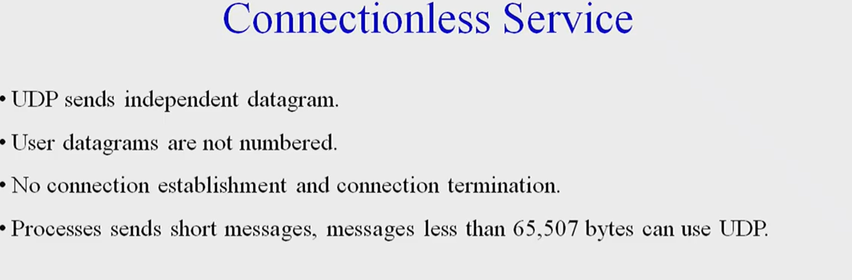

Slide 39
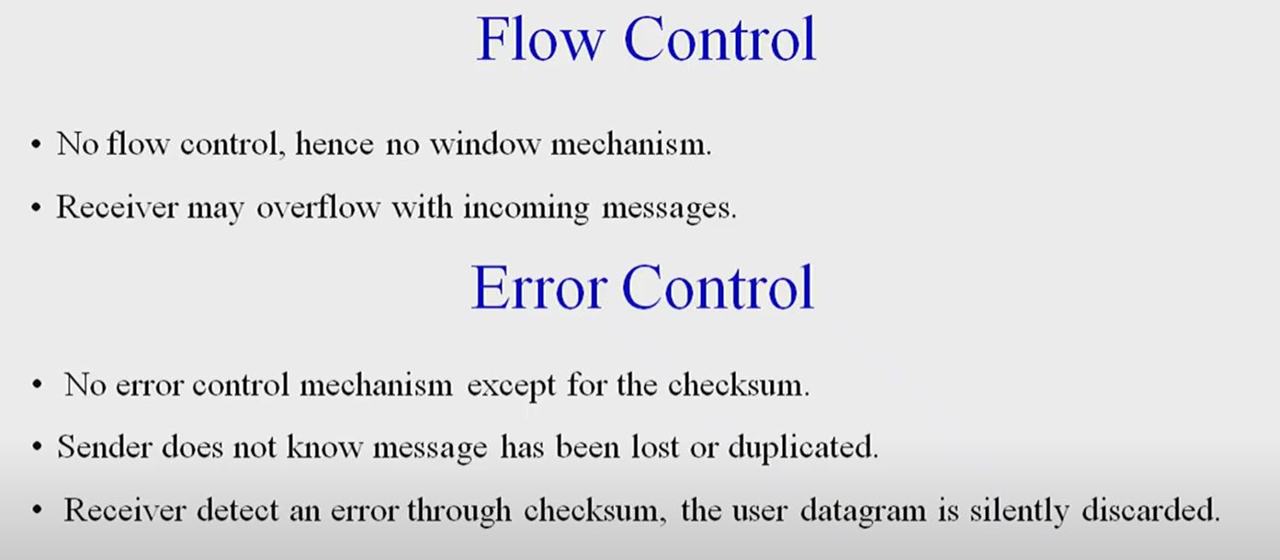

Slide 40
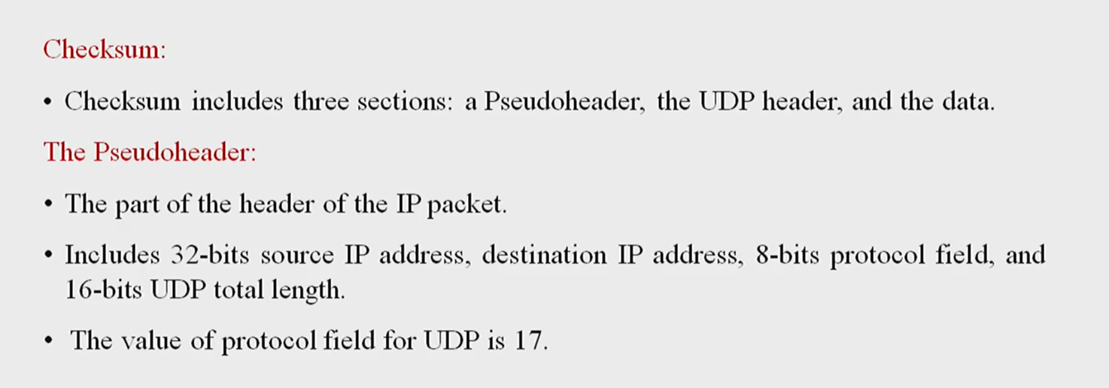

Slide 41
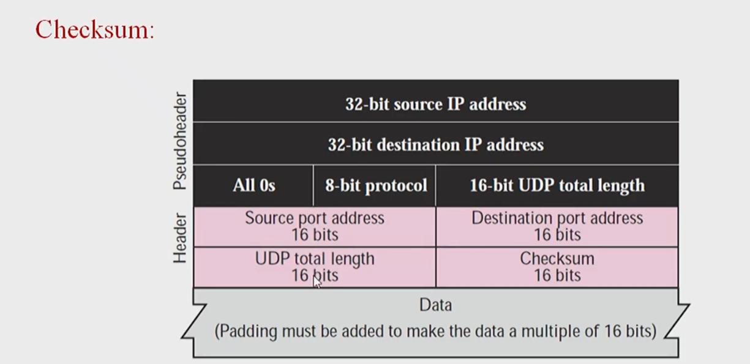

Slide 42
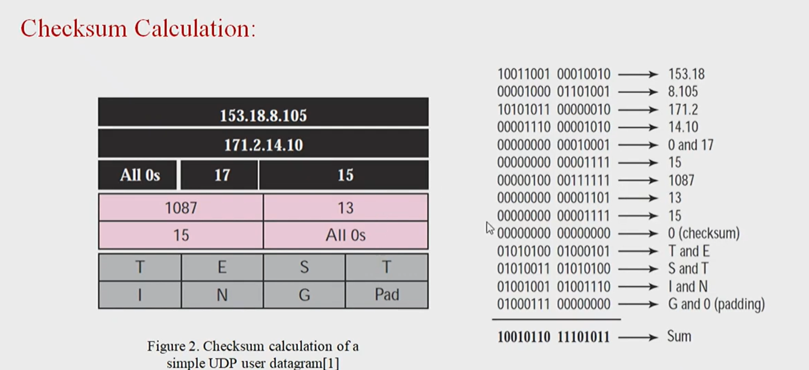

Slide 43
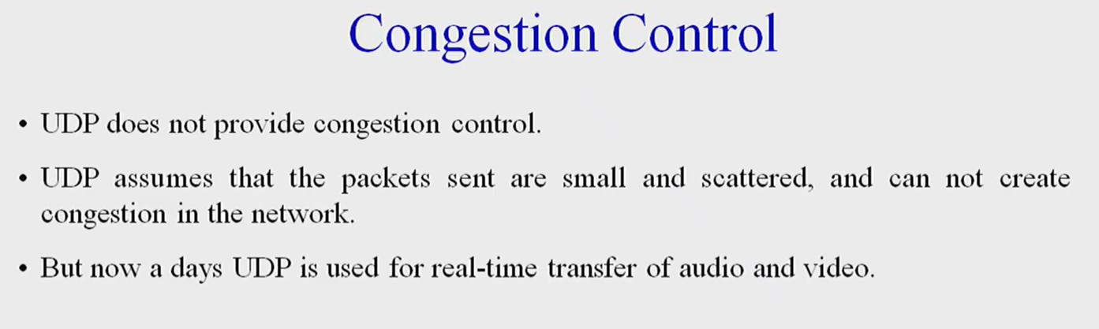

Slide 44
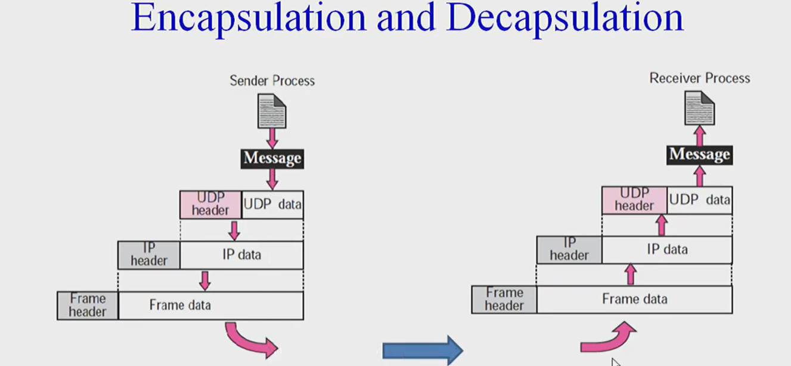

Slide 45
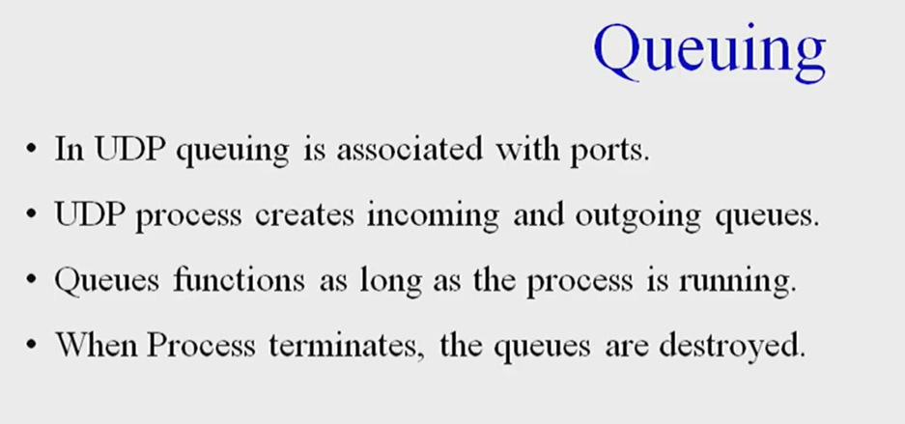

Slide 46
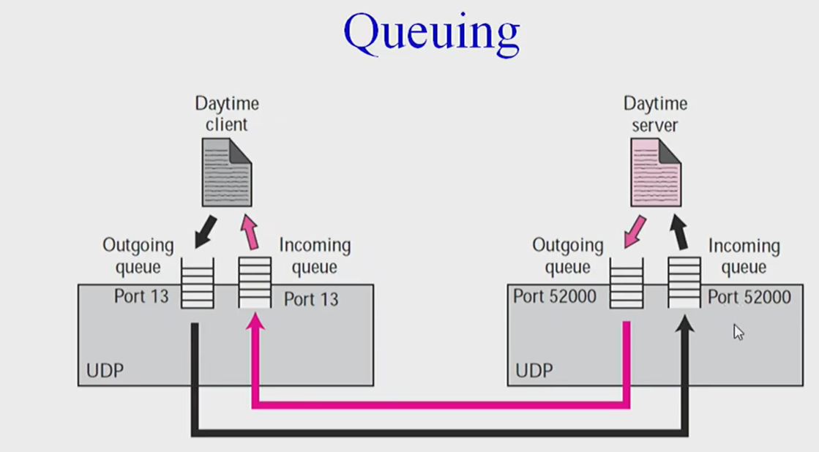

Slide 47
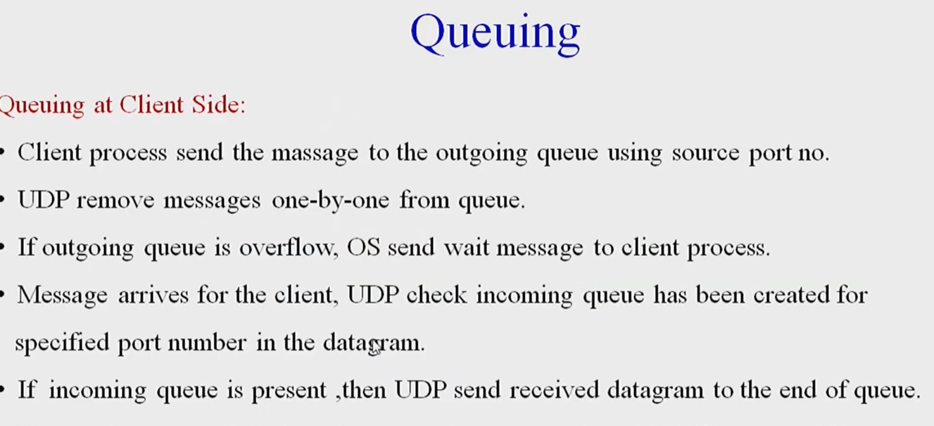

Slide 48
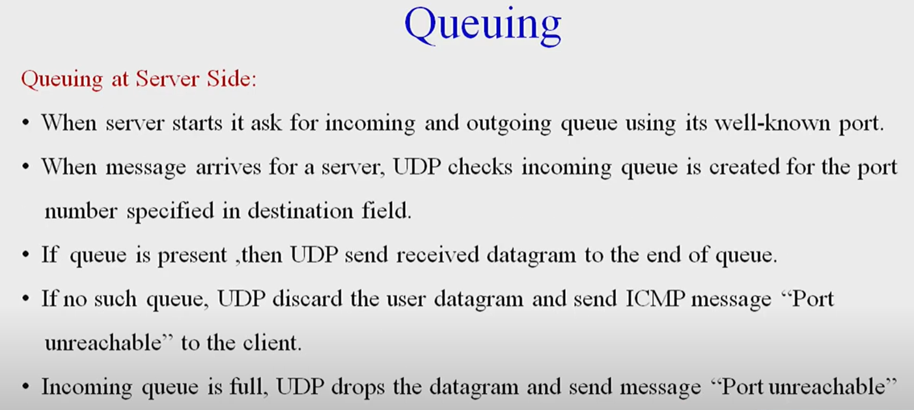

Slide 49
TCP services
Following are some of the services offered by the Transmission Control Protocol (TCP) to the processes at the application layer:
Stream Delivery Service.
Sending and Receiving Buffers.
Bytes and Segments.
Full Duplex Service
Connection Oriented Service.
Reliable Service.

Slide 50
Stream Delivery Service
TCP is a stream-oriented protocol. It enables the sending process to deliver data as a stream of bytes and the receiving process to acquire data as a stream of bytes.
TCP creates a working environment so that the sending and receiving procedures are connected by an imaginary "tube", as shown in the figure below:

Slide 51
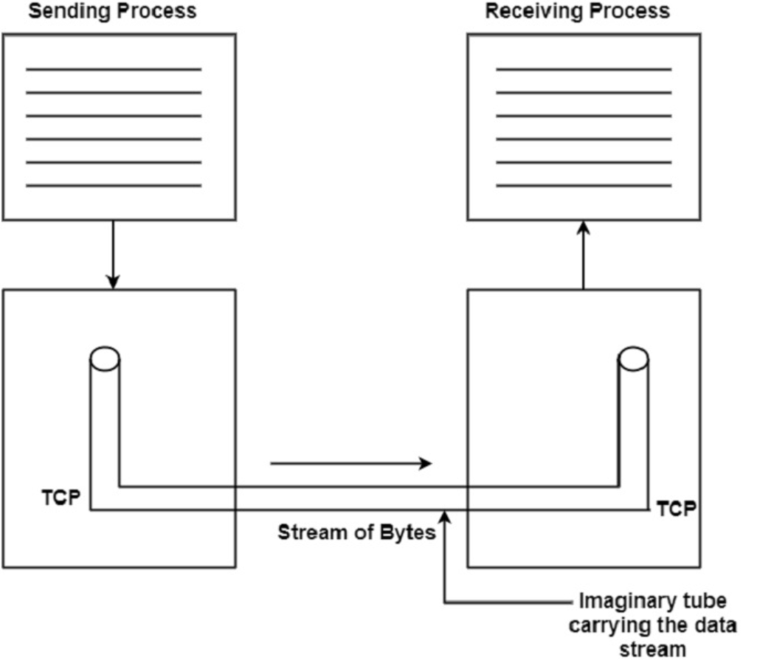

Slide 52
Sending and Receiving Buffers
The sending and receiving processes cannot produce and receive data at the same speed. Hence, TCP needs a buffer for storage.
There are two methods of buffers used in each dissection, which are as follows:
Sending Buffer
Receiving Buffer
The buffer has three types of locations, which are as follows:
Empty Locations.
Locations that contain the bytes which have been sent, but not acknowledged. These bytes are kept in the buffer till an acknowledgment is received.
The location that contains the bytes which are to be sent by the sending TCP

Slide 53
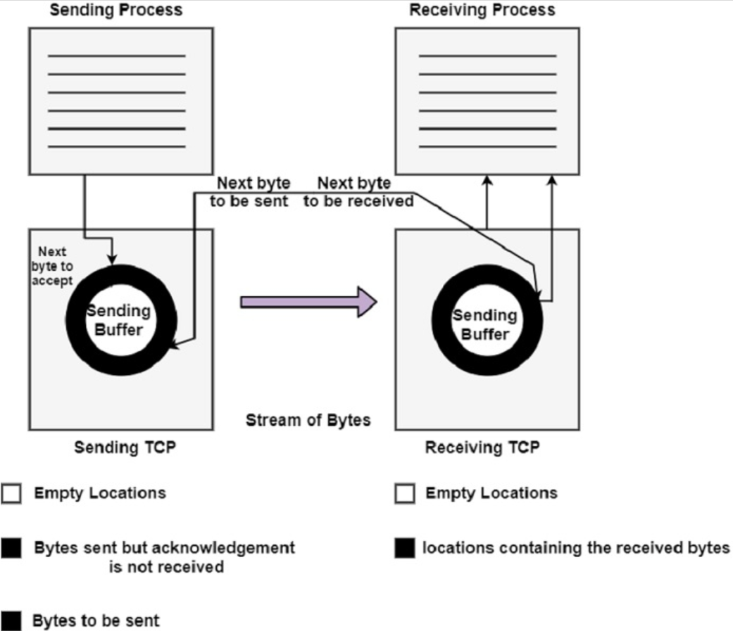

Slide 54
Bytes and Segments
Buffering is used to handle the difference between the speed of data transmission and data consumption. But only buffering is not enough.
We need one more step before sending the data on the Internet Protocol (IP) layer as a TCP service provider. It needs to send data in the form of packets and not as a stream of bytes.
At the transport layer, TCP groups several bytes into a packet and this is called a segment. A header is added to each segment to exercise control.
The segment is encapsulated in an IP diagram and then transmitted. The entire operation is transparent to the receiving process. The segment may be deceived out of order, lost or corrupted when it receives the receiving end.
The figure given below shows how the segments are created from the bytes in the buffers:

Slide 56
Full-Duplex Service
TCP offers a full-duplex service where the data can flow in both directions simultaneously. Each TCP will then have a sending buffer and receiving buffer. The TCP segments are sent in both directions.
Connection-Oriented Service
We are already aware that the TCP is a connection-oriented protocol. When a process wants to communicate (send and receive) with another process (process -2), the sequence of operations is as follows:
TCP of process-1 informs TCP of process-2 and gets its approval.
TCP of process-1 tells TCP of process-2 exchange data in both directions.
After completing the data exchange, when buffers on both sides are empty, the two TCPs destroy their buffers
The type of connection in TCP is not physical, but it is virtual. The TCP segment encapsulated in an IP datagram can be sent out of order. These segments can get lost or corrupted and may have to be resend. Each segment may take a different path to reach the destination.
Reliable Service
TCP is a reliable transport protocol. It uses an acknowledgment mechanism for checking the safe and sound arrival of data.

Slide 57
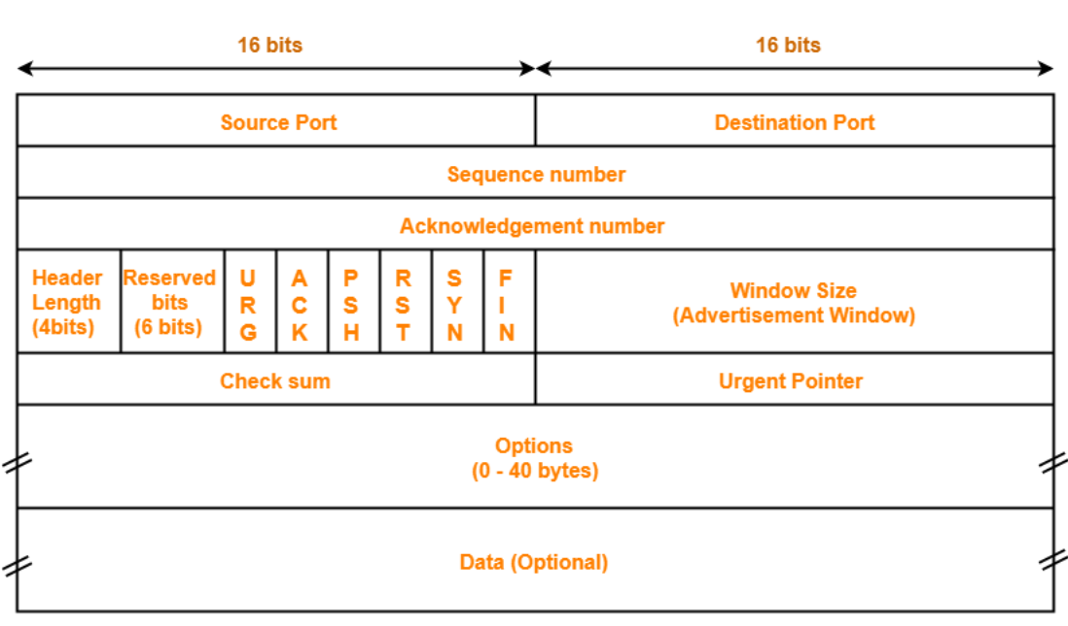
TCP segment

Slide 58
TCP segment = TCP header + Data chunk
Source Port
It is a 16-bit source port number used by the receiver to reply.
Destination Port
It is a 16-bit destination port number.
Sequence Number
The sequence number of the first data byte in this segment. During the SYN Control bit is set, and the sequence number is n, and the first data byte is n + 1.

Slide 59
Acknowledgement Number
If the ACK control bit is set, this field contains the next number that the receiver expects to receive.
Data Offset
The several 32-bit words in the TCP header shows from where the user data begins.
Reserved (6 bit)
It is reserved for future use.

Slide 60
URG
It indicates an urgent pointer field that data type is urgent or not.
ACK
It indicates that the acknowledgement field in a segment is significant, as discussed early.
PUSH
The PUSH flag is set or reset according to a data type that is sent immediately or not.
RST It Resets the connection.
SYN
It synchronizes the sequence number.
FIN
This indicates no more data from the sender.

Slide 61
Window
It is used in Acknowledgement segment. It specifies the number of data bytes, beginning with the one indicated in the acknowledgement number field that the receiver is ready to accept.
Checksum
It is used for error detection.
Options
The IP datagram options provide additional punctuality. It can use several optional parameters between a TCP sender and receiver. It depends on the options used. The length of the field may vary in size, but it can't be larger than 40 bytes due to the header field's size, which is 4 bit.
The most typical option is the maximum segment size MASS option. A TCP receiver communicates to the TCP sender the total length of the segment it can accept with this option.

Slide 62
Padding
Options in each may vary in size, and it may be necessary to "pad" the TCP header with zeros so that the segment ends on a 32-bit word boundary as per the standard.
Data
Although in some cases like acknowledgement segments with no data in the reverse direction, the variable-length field carries the application data from sender to receiver. This field, connected with the TCP header fields, constitute a TCP segment.

Slide 63
TCP Connection
Three-Way HandShake or a TCP 3-way handshake is a process which is used in a TCP/IP network to make a connection between the server and client. It is a three-step process that requires both the client and server to exchange synchronization and acknowledgment packets before the real data communication process starts.
Three-way handshake process is designed in such a way that both ends help you to initiate, negotiate, and separate TCP socket connections at the same time. It allows you to transfer multiple TCP socket connections in both directions at the same time.

Slide 64
TCP message types
Message | Description
Syn | Used to initiate and establish a connection. It also helps you to synchronize sequence numbers between devices.
ACK | Helps to confirm to the other side that it has received the SYN.
SYN-ACK | SYN message from local device and ACK of the earlier packet.
FIN | Used to terminate a connection.

Slide 65
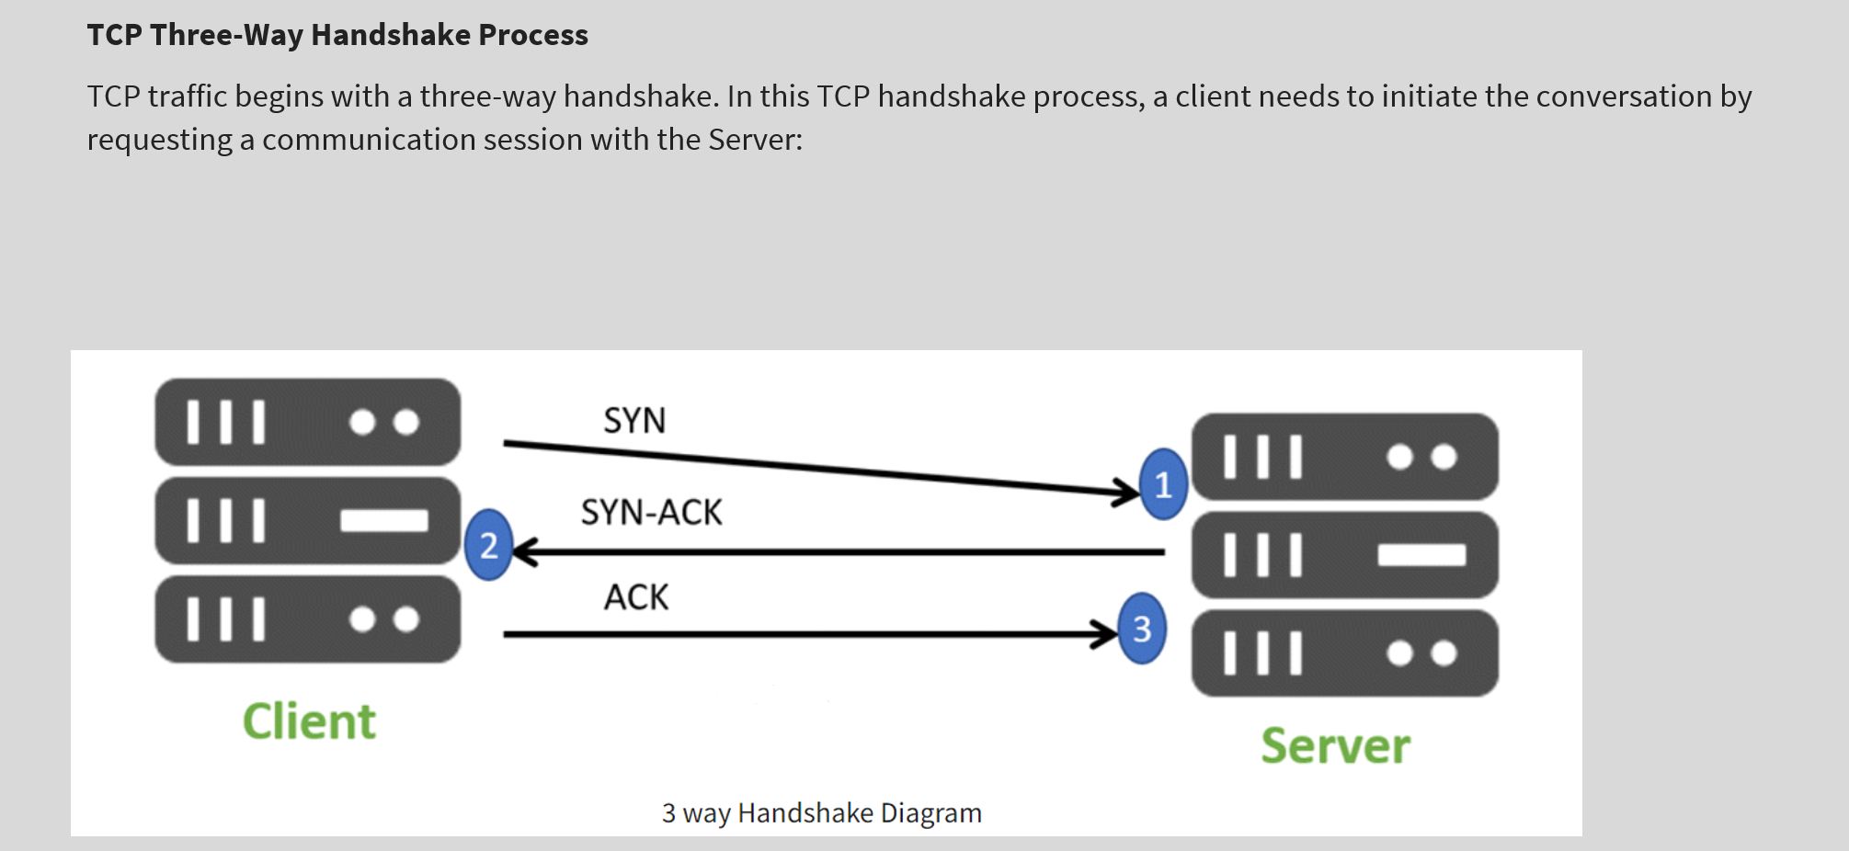

Slide 66
Step 1: In the first step, the client establishes a connection with a server. It sends a segment with SYN and informs the server about the client should start communication, and with what should be its sequence number.
Step 2: In this step server responds to the client request with SYN-ACK signal set. ACK helps you to signify the response of segment that is received and SYN signifies what sequence number it should able to start with the segments.
Step 3: In this final step, the client acknowledges the response of the Server, and they both create a stable connection will begin the actual data transfer process.

Slide 67
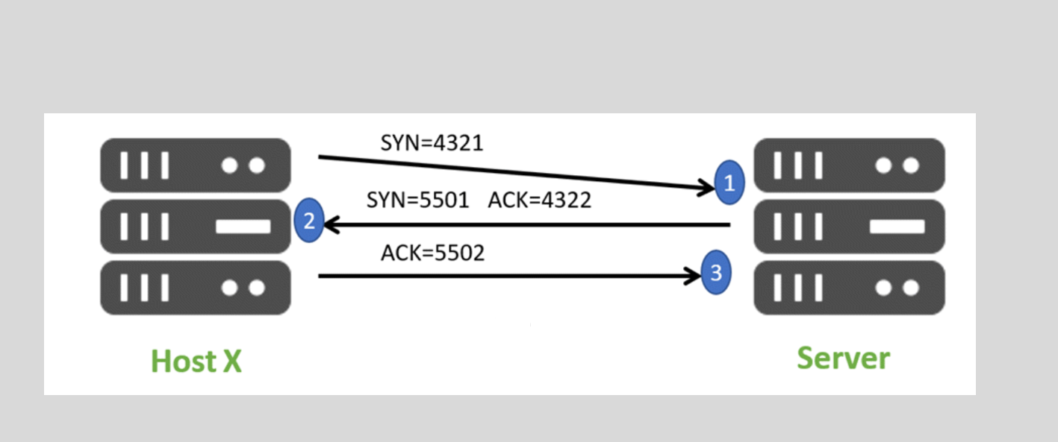
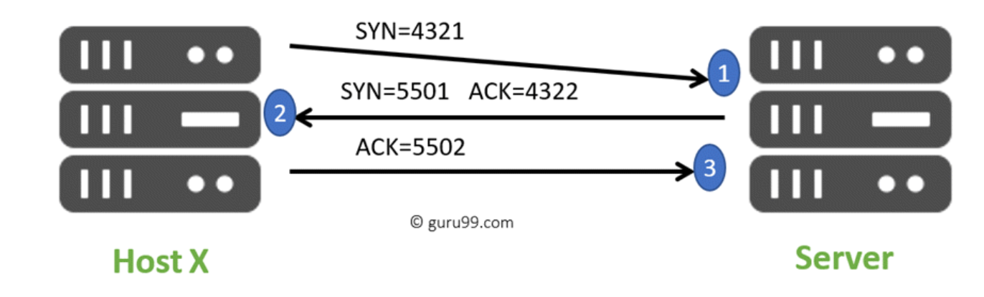

Slide 68
Here is a simple example of the three-way handshake process that is consists of three steps:
Host X begins the connection by sending the TCP SYN packet to its host destination. The packets contain a random sequence number (For example, 4321) that indicates the beginning of the sequence numbers for data that the Host X should transmit.
After that, the Server will receive the packet, and it responds with its sequence number. It’s response also includes the acknowledgment number, that is Host X’s sequence number incremented with 1 (Here, it is 4322).
Host X responds to the Server by sending the acknowledgment number that is mostly server’s sequence number that is incremented by 1.
After the data transmission process is over, TCP automatically terminates the connection between two separate endpoints.

Slide 69
Summary
TCP 3-way handshake or three-way handshake or TCP 3-way handshake is a process which is used in a TCP/IP network to make a connection between server and client.
Syn use to initiate and establish a connection
ACK helps to confirm to the other side that it has received the SYN.
SYN-ACK is a SYN message from local device and ACK of the earlier packet.
FIN is used for terminating a connection.
TCP handshake process, a client needs to initiate the conversation by requesting a communication session with the Server
In the first step, the client establishes a connection with a server
In this second step, the server responds to the client request with SYN-ACK signal set
In this final step, the client acknowledges the response of the Server
TCP automatically terminates the connection between two separate endpoints.

Slide 70
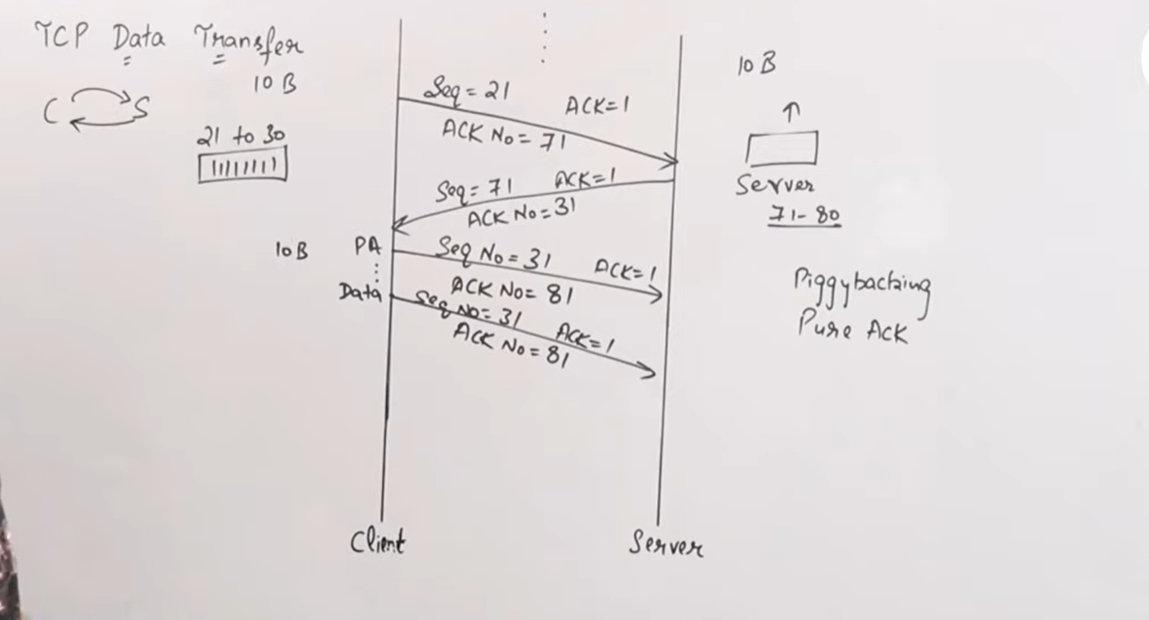
Data Transfer in TCP

Slide 71
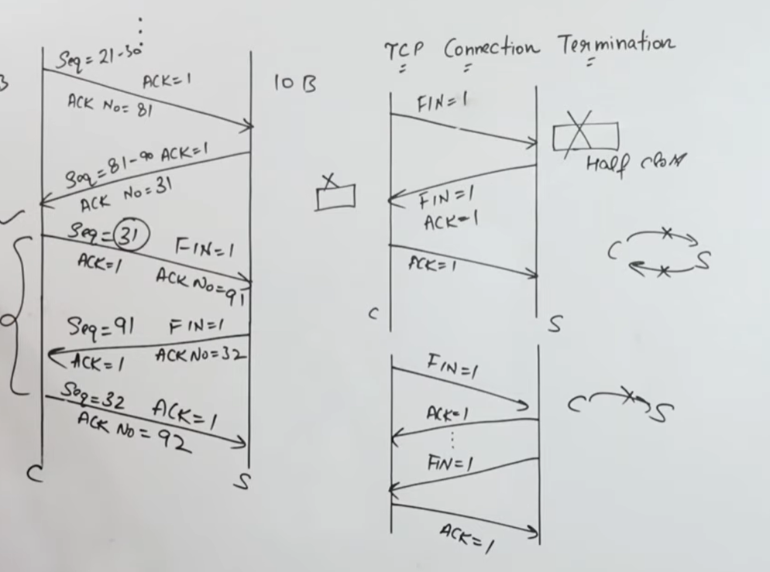
Connection termination in TCP

Slide 72
TRANSPORT-LAYER PROTOCOLS
Simple connectionless protocol
No flow control and error control
Connection-oriented protocol
Stop-and-Wait protocol
Provide flow and error control
Go-Back-N protocol
Efficient version of Stop-and-Wait protocol
Selective-Repeat Protocol
Suited to handle packet loss
Piggybacking

Slide 73
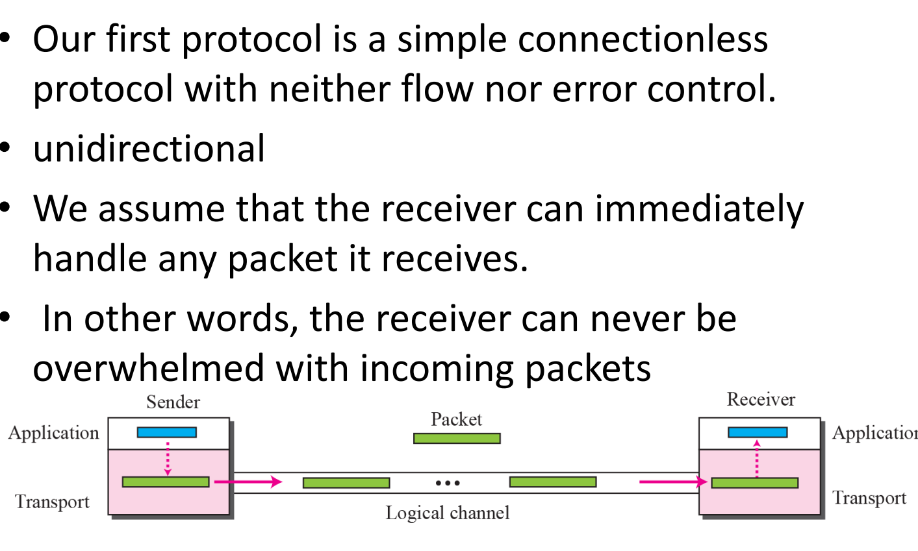
Simple Protocol

Slide 74
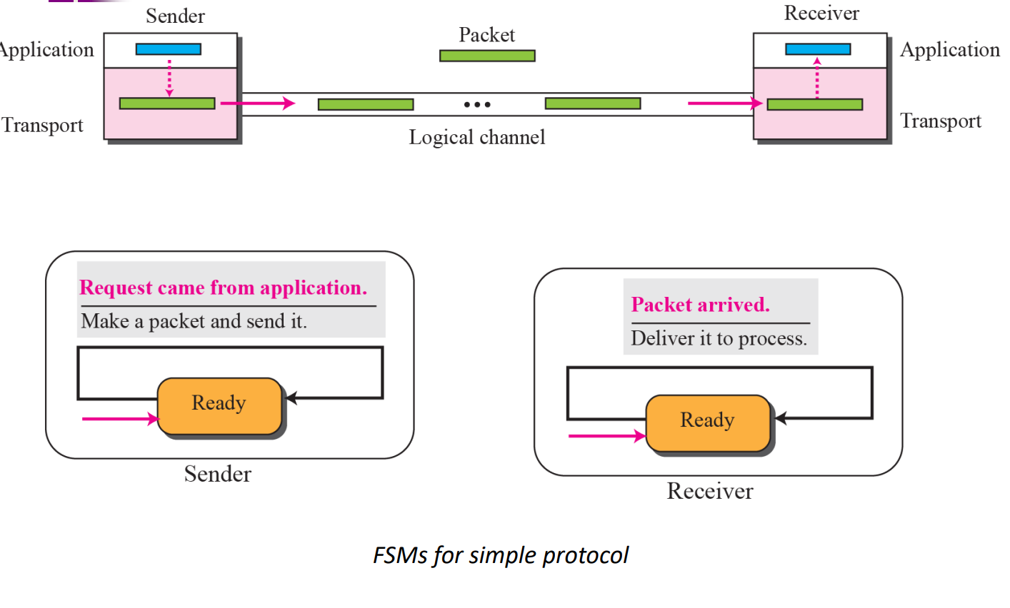

Slide 75
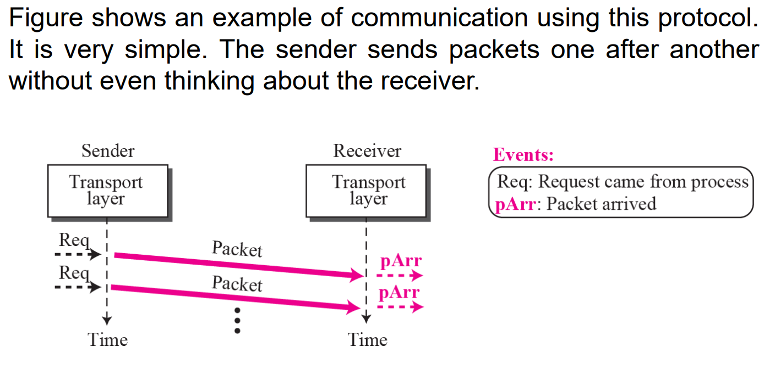

Slide 76
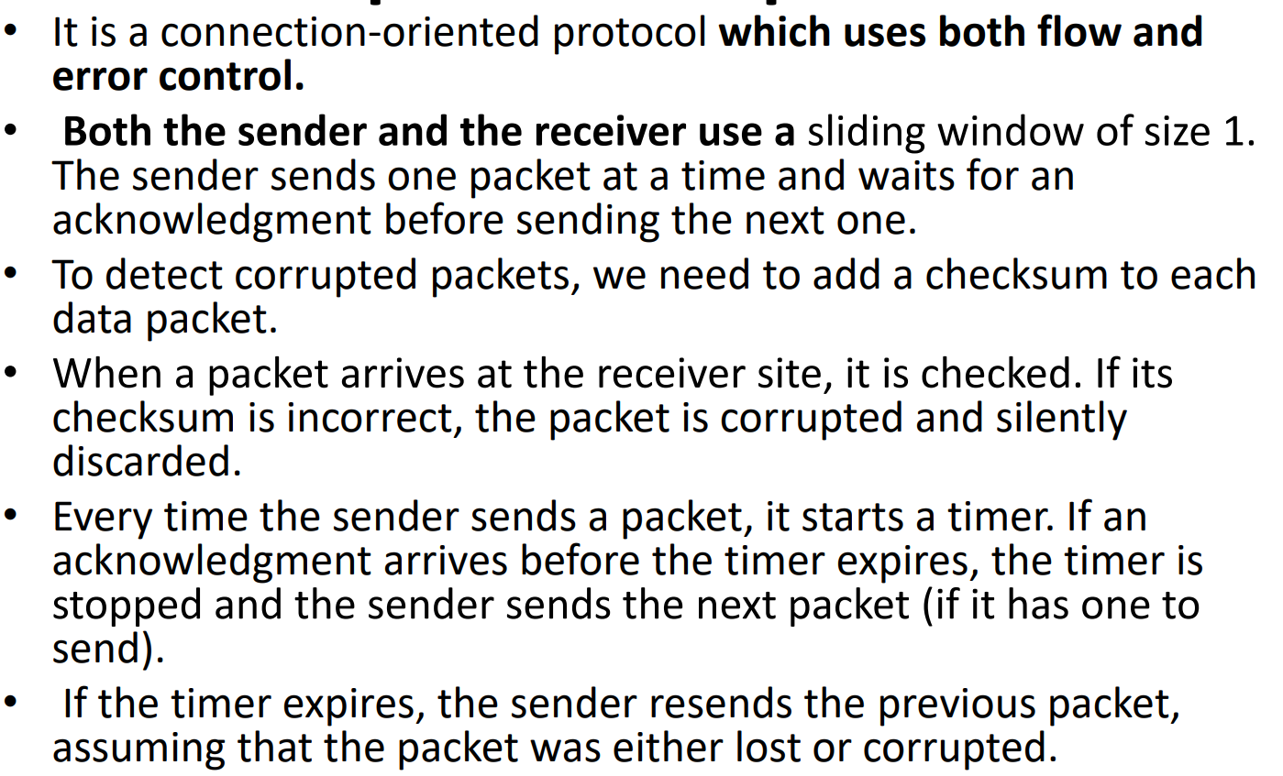
Stop and wait protocol

Slide 77
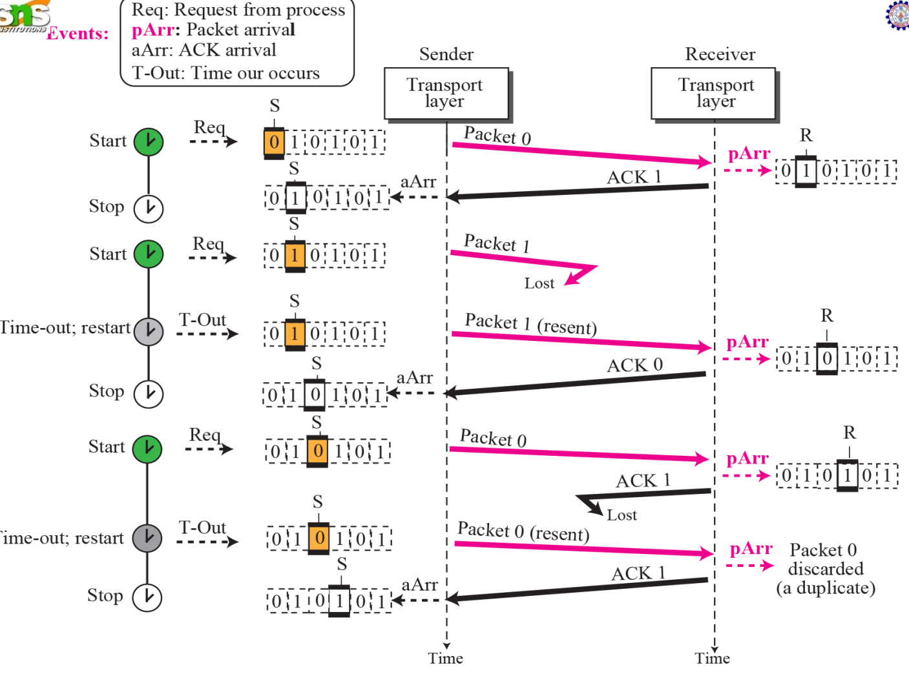

Slide 78
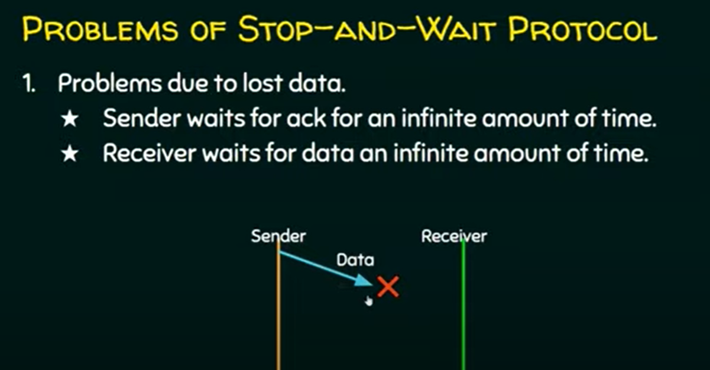

Slide 79
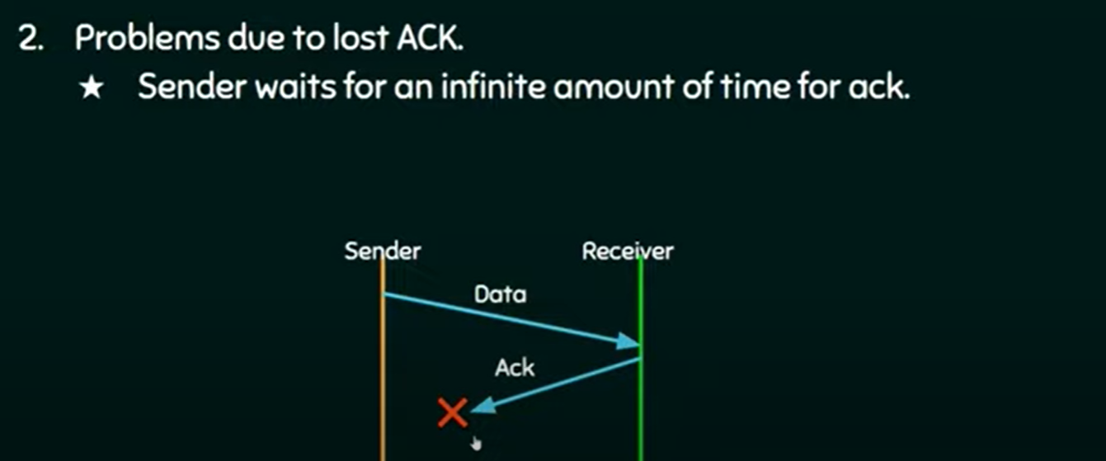

Slide 80
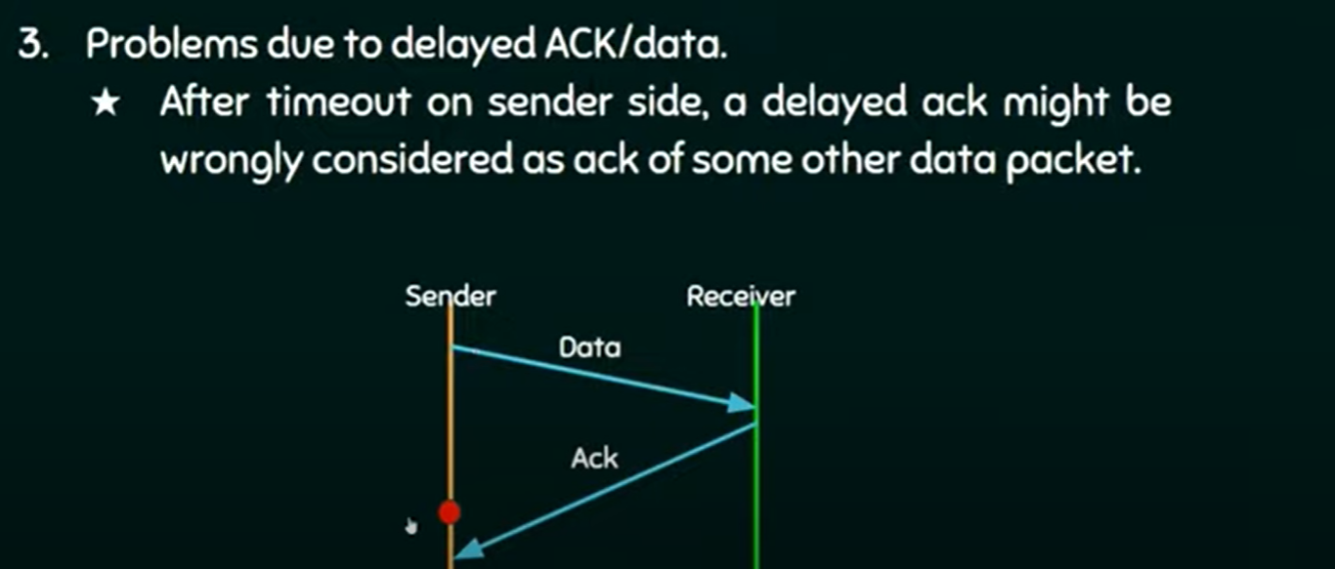

Slide 81
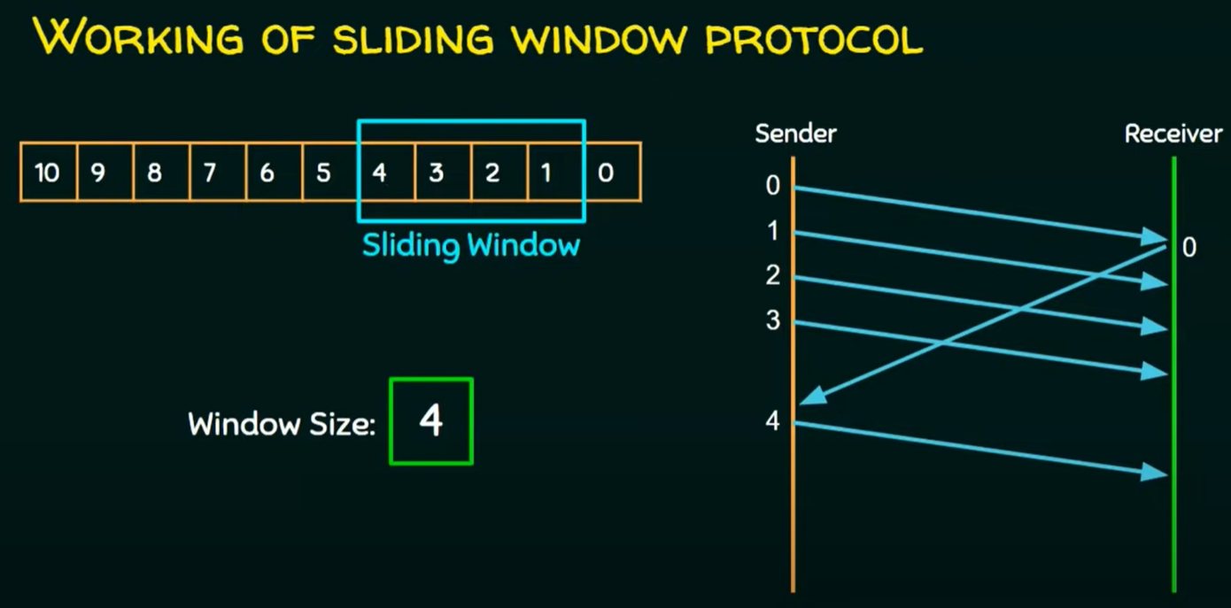
Sliding window protocol

Slide 82
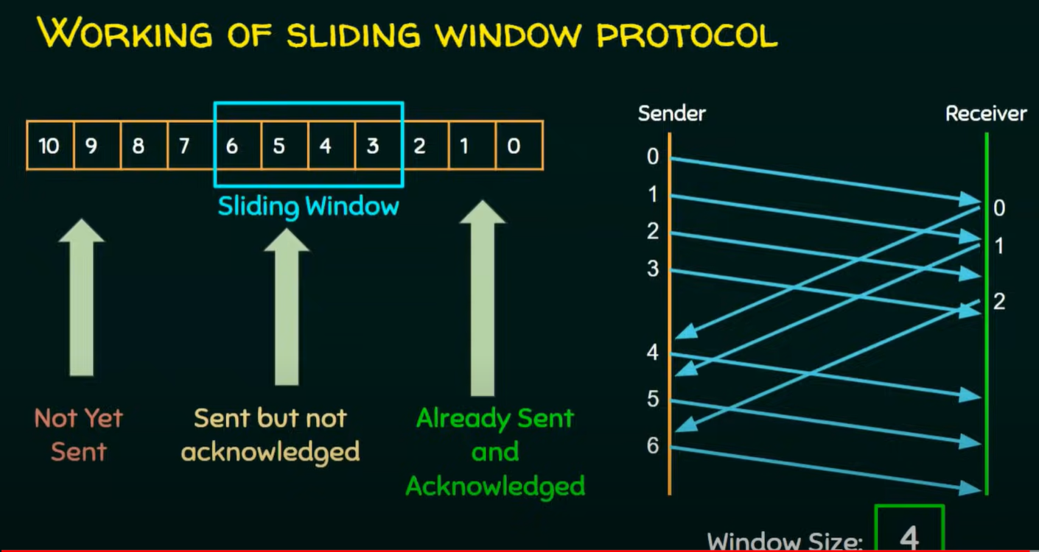

Slide 83
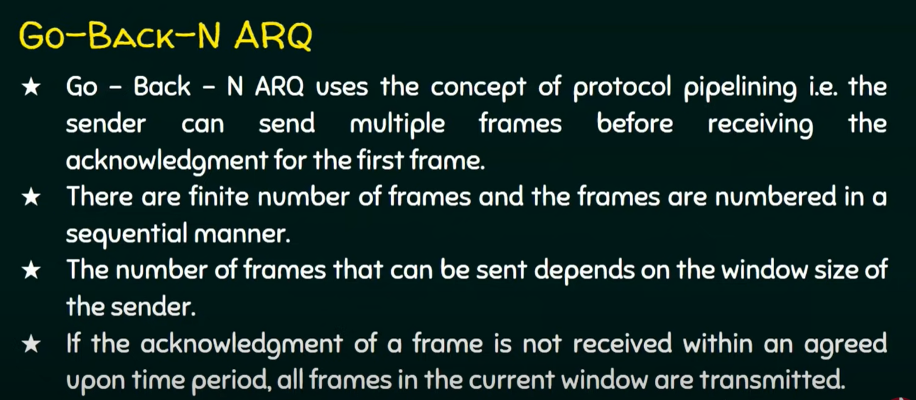
Go-Back –N ARQ

Slide 84


Slide 85


Slide 86


Slide 87


Slide 88


Slide 89

Selective Repeat ARQ

Slide 90


Slide 91


Slide 92


Slide 93


Slide 94


Slide 95


Slide 96


Slide 97


Slide 98


Slide 99


Slide 100



Slide 101

Lost acknowledgement

Slide 102

Lost acknowledgment corrected by resending a segment

Slide 103

TCP Congestion control

Slide 104


Slide 105


Slide 106


Slide 107


Slide 108

Congestion avoidance additive increase

Slide 109


Slide 110

Example of Taho TCP

Slide 111


Slide 112


Slide 113
Session Layer:
Session layer design issues
Session Layer protocol - Remote Procedure Call (RPC),

Slide 114
5th layer of OSI Reference Model
Responsible for
Opening session
Managing session
Terminating session

Slide 115

For two computer to communicate there must be channels – open
May have more than one channel
Through the channels the messages are transmitted
Channels are nothing but Sessions
Session layers is not concerned about data integrity
Associated with the exchange of data
provide a way for devices or nodes to communicate.

Slide 116
Session layer provides services like
Authentication,
Authorization,
Dialog Control,
Dialog separation

Slide 117
Authentication
Authentication is done on the network devices.
verifying who you are
Logging on to a server with a username and password is authentication.
The main purpose of authentication is security.
Without authentication, user's data stored on a server is unsafe on the grounds that everyone can get it from the server.

Slide 118
Authorization
After being authenticated
process of verifying what a user is entitled to do or access on a given server
authorization is configured on every server
It is to avoid intrusion on users' personal data
dialog control
it determines whose turn it is to transfer data in a session
In a given open session, a device plays dual roles, which is requesting services and replying with services.

Slide 119
Dialog control determines which role they are playing at any given moment.
dialog control is critically significant for data transmission.
provides three different modes or ways of communication, which are
simplex
eg: Radio
half-duplex
eg: Walkie talkie
full-duplex
eg: skype

Slide 120
Dialog separation
It is concerned with the initiation, termination, and managing of communication.
error occurred during transmission which led to the loss of data. In this case, computer has to resend the lost data as well as the received ones.
It is responsible for solving problems that may occur during data transmission. It allows users to resume data transfer from where an error happens without any need to start over.

Slide 121

when an error occurs during transmission, the sender does not need to start sending data from the beginning, it rather start from where it breaks. This is achieved through synchronization.
If the session is closed by mistake, the dialog separation has the ability to re-establish the connection and start from where it leaves off.
During the transmission of data, dialog separation allows a process to add checkpoints to each set of data.
each piece of data is assigned a sequence number
when an error occurs, the receiver can re-synchronize the state of the session to a previous synchronization point.

Slide 122

Remote Procedure call

Slide 123


Slide 124


Slide 125


Slide 126


